Slide 1
ENSEMBLE METHODS
BAGGING & BOOSTING

Slide 2
Lets Discover…
01
Intro to Ensembles
Lets Understand What is Ensemble Modelling
02
Titanic Example
This example will give better Idea about Ensembles.
03
What is Bagging
Random Forest, Bias Variance Trade-Off & Much More…
04
What is Boosting
Boosting Process…

Slide 3
Lets Dive In…

Slide 4
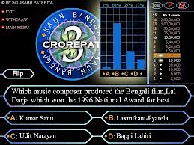
Ensemble Methods
Lets Take an Example of KBC Gameshow
Vs
Phone a Friend in KBC
Audience Poll
Image Source: Google

Slide 5
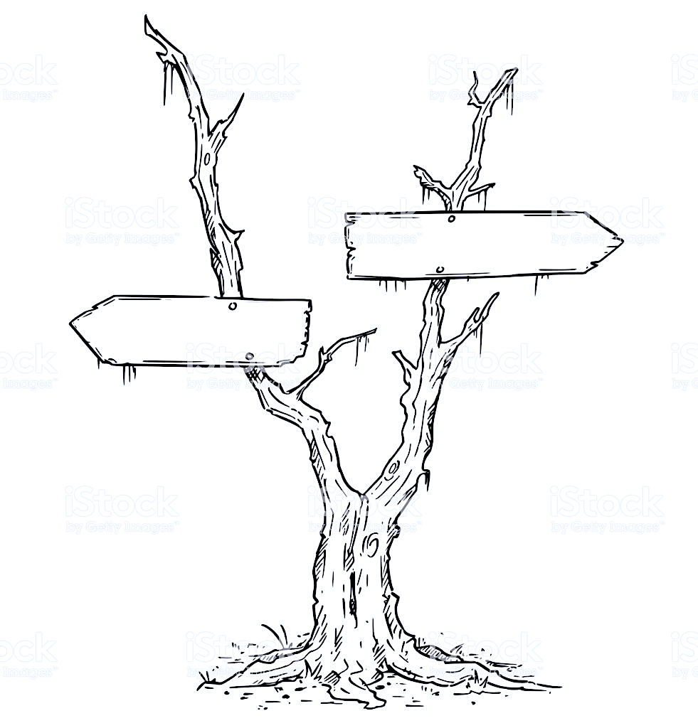

Ensemble Methods
Asking a Single Person resembles like a Single Tree
Asking a Group of People resembles like multiple Decision Trees
Random Forest
Decision Trees
Vs
Phone a Friend in KBC
Audience Poll
Image Source: Google

Slide 6

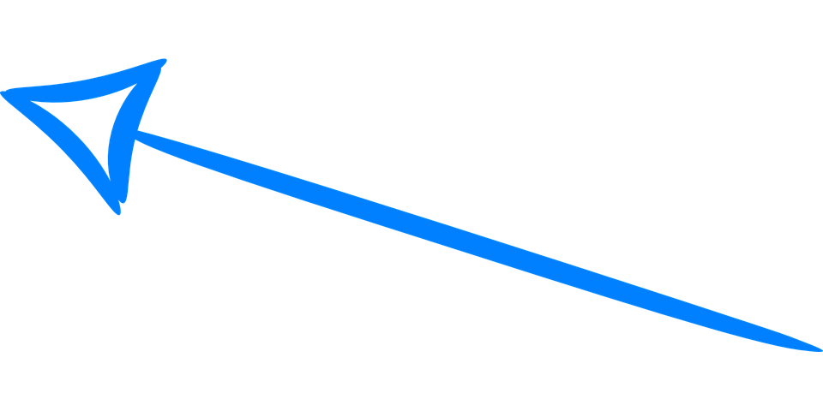

Titanic Disaster
Predictor Variables:
Age, Fare, Gender, Passenger Class, Name,
Siblings, Spouse, Port of Embarkation etc..
Target Variables:
Survived – Yes/No
Here we take Survived as 1 and Others as 0
Decision Trees Algorithm
Accuracy 74%
Features &
Labels
Logistic Regression
Accuracy 72%
Vote by Majority
Support Vectors
Accuracy 76%
Image Source: Google

Slide 7
Titanic Disaster – What is Majority Vote
Predictor Variables:
Age, Fare, Gender, Passenger Class, Name,
Siblings, Spouse, Port of Embarkation etc..
Target Variables:
Survived – Yes/No
Learning Algorithm
Prediction
Test Labels
Decision Trees
Survived
Survived
1 or 0
Voted
Survived
Logistic Regression
Survived
Support Vectors
Not Survived
Image Source: Google

Slide 8
Ensemble Process
Key Pointers:
The Purpose of is to improve Accuracy
Reduce Variance & Bias.
Don’t Use Stable Models in Ensembling.
Learners should have high variance & should be unstable e.g. Decision Trees
Diversity In models should exist.
End to End Process
Selecting the Dataset
Taking “D” Dataset
Aggregation
Generate Samples
We will combine those models to improve the overall Accuracy. In classification, Voting is used & in Regression Models, we use Average.
Here, we will generate multiple samples (“M”) from the “D” Dataset. The sampling will be done by Replacement. This is called Bootstrap Sampling
Generating Multiple Models
Applying Learners
The learners on ”M” samples would generate multiple models with different Accuracy Levels
Once the “M” samples are generated. The learners are applied to train the classifier.
Its like using multiple ML algorithms on the same problem and then combining it to produce a better model
Image Source: Google

Slide 9
Stable Learners…
“
“
Therefore Combining Stable Learners is less advantageous since the ensemble will not improve generalization performance.

Slide 10
Thus, Ensemble is…
“
“
It is a ML Technique that combines several base models (learners) in order to produce one optimal predictive model.

Slide 11
Over Fitting & Underfitting

Slide 12
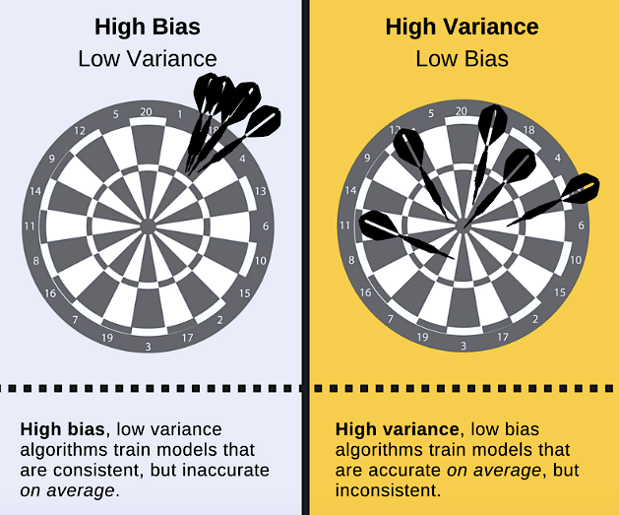
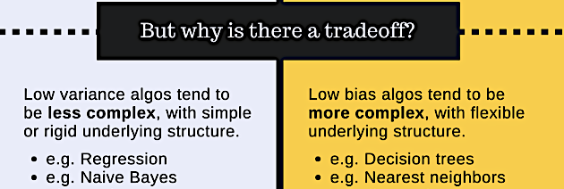
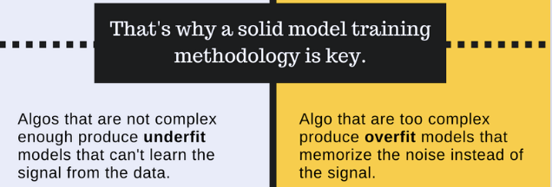
Bias Variance Trade Off
Understanding Prediction Error

Slide 13
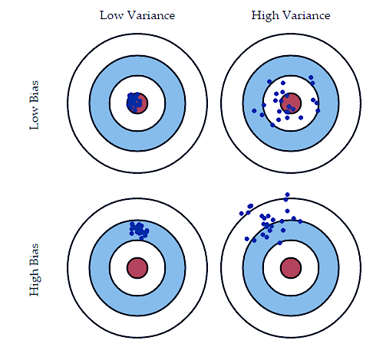
Bias Variance Trade Off
Understanding Prediction Error - Bias
Error due to Bias is the difference between the expected (or average) model prediction and the correct value or true value.
E[Y’ – Y]: Y’ is Predicted Value & Y is Actual Value.
Imagine Running Multiple models several times will have the range of predictions.
Bias is how far off these model predictions are from correct value.
A High Bias and Low Variance Model is an Underfitted Model
A high bias algorithm is easy to learn but less flexible, due to this they have lower predictive performance.
Examples: Linear Regression, Logistic Regression etc.

Slide 14
Bias Variance Trade Off
Understanding Prediction Error - Variance
Error due to Variance is the variability in the results of a model when the dataset is changed.
High Variance increases the spread of points which results in less accurate predictions.
A Low Bias and High Variance Model is an Overfitted Model
Variance is how much the predictions for a given point vary between different samples of the training data.
Model with high variance pays a lot of attention to the training data and does not generalize well on the test data.
A low bias algorithm is not easy to learn but highly flexible, due to this they have higher predictive performance.
Examples: Decision Trees, Neural Net etc.

Slide 15
Bagging

Slide 16
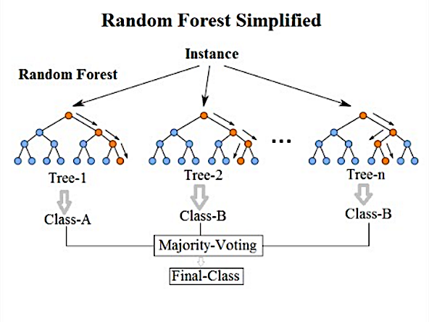
What is Bagging
Decision Trees overfit the model and increases the variance. This makes the model vulnerable.
Bagged Trees averages many models to reduce the variance.
Although, Bagging is often applied to Decision Trees but it can be used with any type of method
In addition to reducing variance, it also helps avoid overfitting.
Bootstrap AGGregatING.
Bootstrap Sampling means sampling rows from the training data with replacement.
This means that a single training example can be repeated more than once.
Image Source: Google

Slide 17
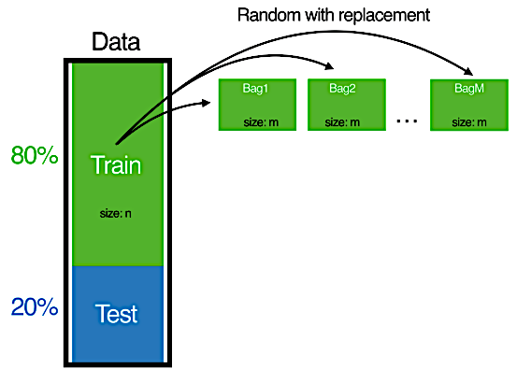
How Bagging Works
Step1 – Draw m Samples from with replacement from original training set where m is a no less than or equal to N.
Note - With Bagged Trees, the common choice for m is one-half of N.
Image Source: Google

Slide 18
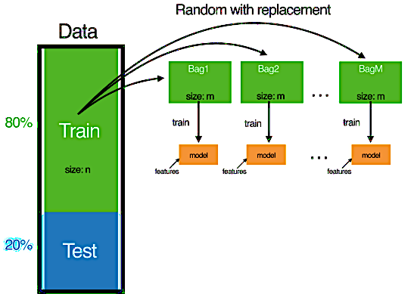
How Bagging Works
Step1 – Draw m Samples from with replacement from original training set where m is a no less than or equal to N.
Note - With Bagged Trees, the common choice for m is one-half of N.
Step2 – Train the Decision Trees on the newly created bootstrapped samples.
This Step 1 and Step 2 can be repeated n no of times. Typically more trees, the better the model.
Image Source: Google

Slide 19
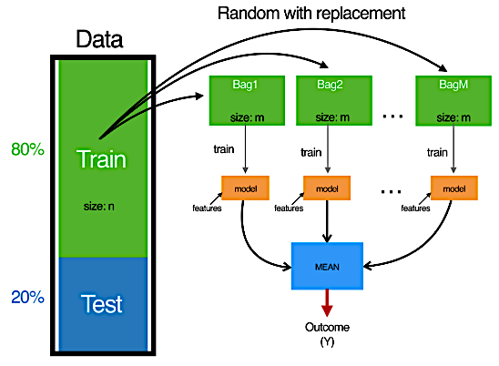
How Bagging Works
Step1 – Draw m Samples from with replacement from original training set where m is a no less than or equal to N.
Note - With Bagged Trees, the common choice for m is one-half of N.
Step2 – Train the Decision Trees on the newly created bootstrapped samples.
This Step 1 and Step 2 can be repeated n no of times. Typically more trees, the better the model.
Step3 – To Generate the Prediction, we would simply average the predictions from these models created on m samples, to get a final prediction.
Bagging can dramatically reduce the variance of unstable models (e.g. Decision trees) leading to improved Prediction.
Averaging reduces variance but leaves the bias unchanged
Image Source: Google

Slide 20
Boosting

Slide 21
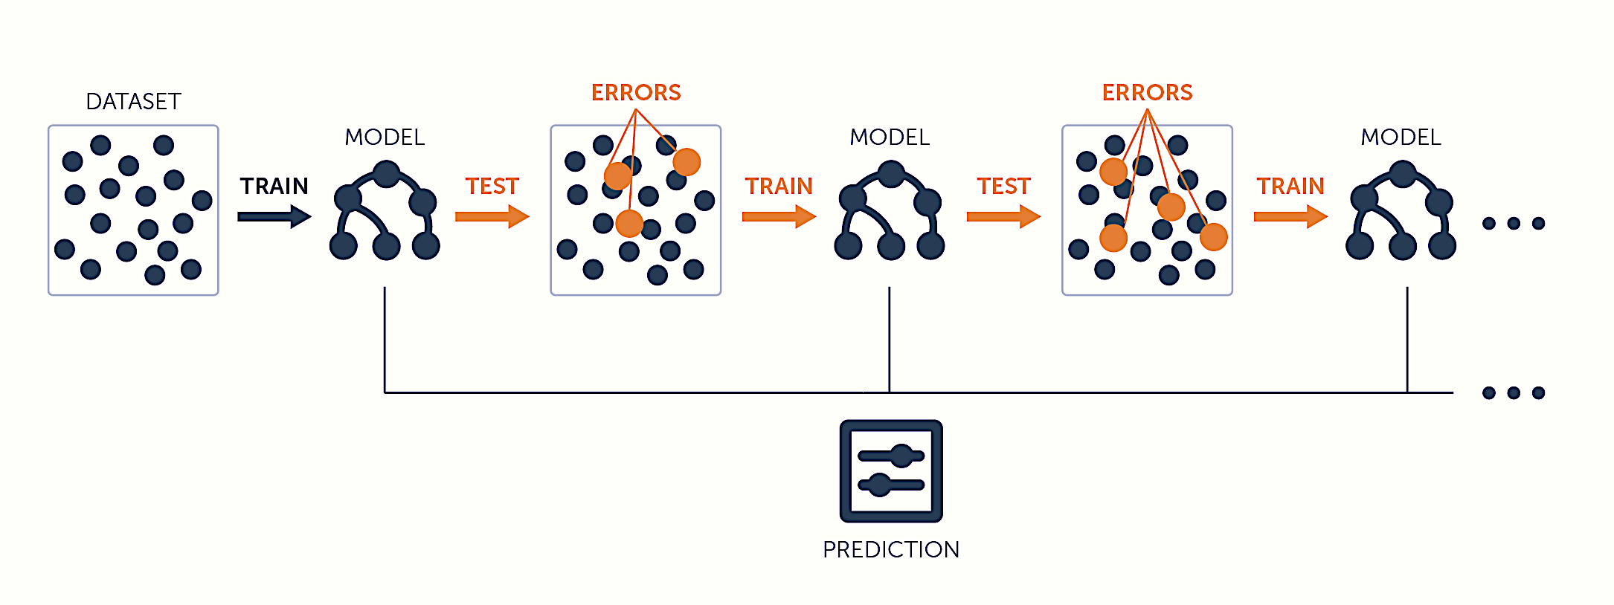
What is Boosting
An Overview
Boosting is a sequential process, where each subsequent model attempts to correct the errors of the previous model
The succeeding models are dependent on the previous model.
Boosting gives mis-classified samples higher preference/weight.
It is a method to “boost” weak learning algorithm (“single tree”) into strong learning algorithm.
Image Source: Google

Slide 22
What is Boosting
End to End Process
Let’s understand the way boosting works in the steps:
A subset is created from the original dataset.
Initially, all data points are given equal weights & a base model is created on this subset.
This model is used to make predictions on the whole dataset.
Errors are calculated using actual values & predicted values.
The observations which are incorrectly predicted, given higher weights.
6. Another model is created & predictions are made on the dataset.
7. The model tries to correct the error from the previous dataset.
8. Similarly, multiple models are created to reduce the errors of the previous model.
9. The final model is the weighted mean of all models.
Image Source: Google

Slide 23
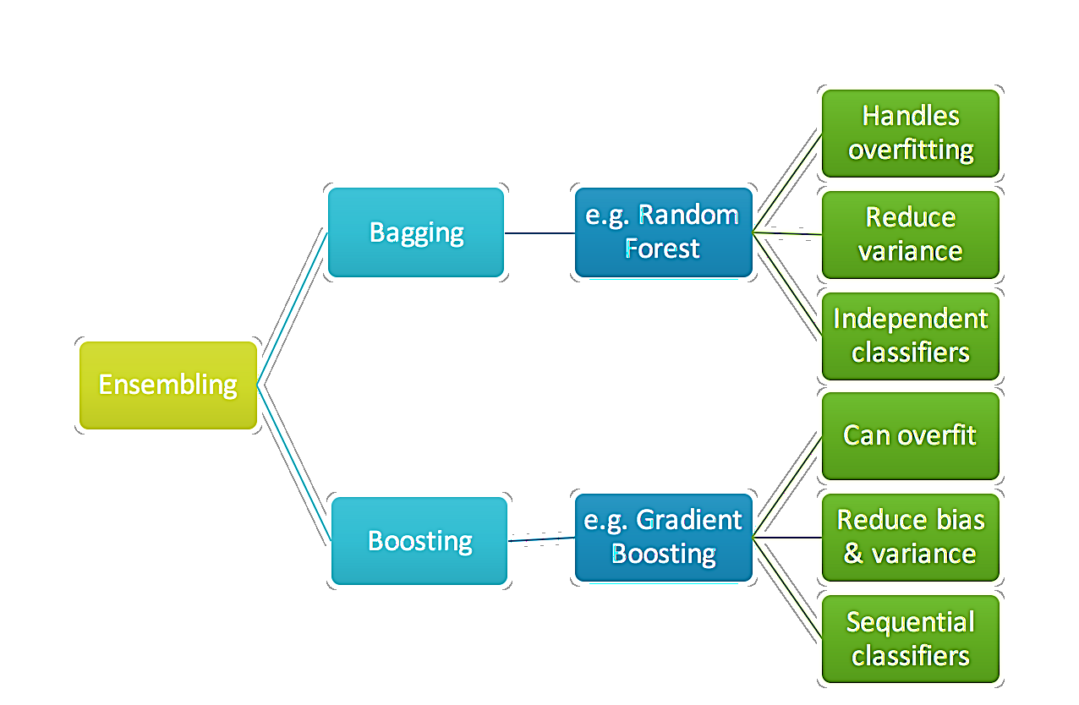
Difference between Bagging & Boosting
Bagging
Boosting
In bagging, Individual Trees are Independent of each others & is a method of improving performance by aggregating result of weak learners.
In boosting, Individual Trees are Not Independent of each other because the trees correct the result of previous trees.
Training stage is parallel in Bagging. This means that each model is built independently.
Training stage is sequential in Boosting. This means weights are assigned to the data.
The purpose of Bagging is to reduce Variance. It may solve the problem of Over-fitting
The purpose of Boosting is to reduce Bias. It may increase the overfitting in the data.

Slide 24
Cross Validation

Slide 25
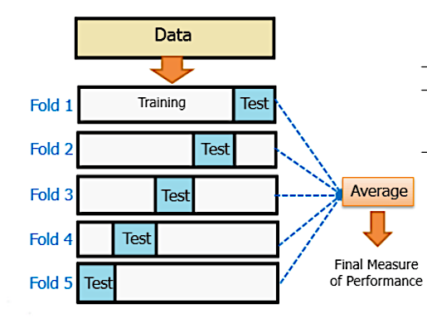
What is Cross Validation
An Intro
Cross Validation:
Need assurance that model has picked up most of patterns & is not picking up too much noise.
In other words, its low on variance & bias.
The Dataset is randomly partitioned in k equal sized samples.
Out of k samples a single sub sample is retained as validation dataset for testing the model and remaining k-1 are used for training data.
This process is repeated k times and the results can be averaged out to produce a single estimation.
Image Source: Google
Image Source: Google
Image Source: Google

Slide 26
What is Cross Validation
End to End Process
Cross Validation:
Don’t know how accurately a predictive model would perform in practice.
The Dataset is randomly partitioned in k equal sized samples.
Out of k samples a single sub sample is retained as validation dataset for testing the model and remaining k-1 are used for training data.
This process is repeated k times and the results can be averaged out to produce a single estimation.
Image Source: Google
Image Source: Google
Image Source: Google

Slide 27
Movie Review

Slide 28
Dark Knight..
Movie Review
You went out to ask for the rating of the movie
Ask Friends
Ask 05 of your colleagues
Asking 100 people
Use Simple Ensembles
Simple Ensemble Techniques
Max Voting
Averaging
Weighted Averaging

Slide 29
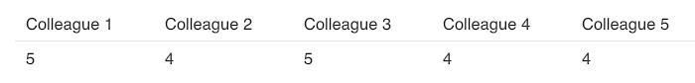
Max Voting
Movie Review
The max voting method is generally used for classification problems. In this technique multiple models are used to make predictions for each data point.
The predictions by each model are considered as a ‘vote’. The predictions which we get from the majority of the models are used as the final prediction.
For example, when you asked 5 of your colleagues to rate your movie (out of 5); we’ll assume three of them rated it as 4 while two of them gave it a 5.
Tip: Lets Code this using Voting Classifier

Slide 30
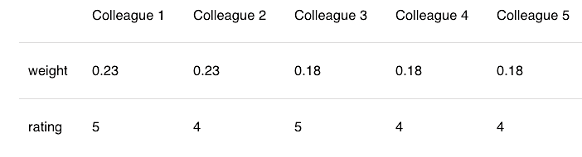
Averaging
Movie Review
This is an extension of Averaging.
All the models are assigned different weights defining the importance of each model for prediction.
For instance, two colleagues are critics, while others have no prior experience.
Thus, different weights have been assigned as you can see below
The result is calculated as [(5*0.23) + (4*0.23) + (5*0.18) + (4*0.18) + (4*0.18)] = 4.41.
i.e. (5+4+5+4+4)/5 = 4.4
Tip: The weights are assigned Arbitrarily

Slide 31
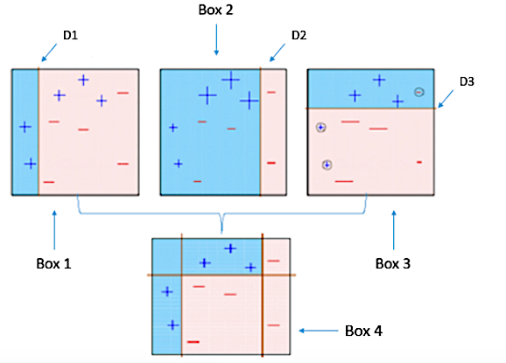
ADABoost
It fits a sequence of weak learners on different weighted training data.
It starts by predicting original data set and gives equal weight to each observation.
If prediction is incorrect using the first learner, then it gives higher weight to observation which have been predicted incorrectly.
Being an iterative process, it continues to add learner(s) until a limit is reached in the number
of models or accuracy.

Slide 32
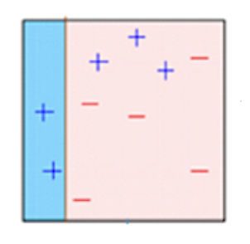
ADABoost
Box 01
Box 1: You can see that we have assigned equal weights to each data point and applied a decisioning to classify them as + (plus) or – .
The Decisioning (D1) has generated vertical line at left side to classify the data points.
We see that, this vertical line has incorrectly predicted three + (plus) as – (minus). In such case, we’ll assign higher weights to these three + (plus) and apply another decisioning layer.

Slide 33
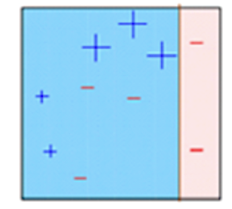
ADABoost
Box 02
Box 2: Here, you can see that the size of three incorrectly predicted + (plus) is bigger as compared to rest of the data points.
In this case, the second decisioning model (D2) will try to predict them correctly.
Now, a vertical line (D2) at right side of this box has classified three mis-classified + (plus) correctly.
But again, it has caused mis-classification errors. This time with three -(minus). Again, we will assign higher weight to three – (minus) and apply another decision layer.

Slide 34
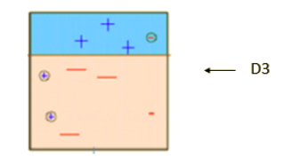
ADABoost
Box 03
Box 3: Here, three – (minus) are given higher weights.
A decision layer (D3) is applied to predict these mis-classified observation correctly.
This time a horizontal line is generated to classify + (plus) and – (minus) based on higher weight of mis-classified observation.

Slide 35
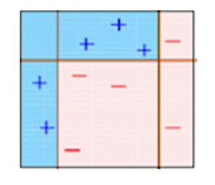
ADABoost
Box 04
Box4: Here we have combined D1, D2 and D3 layers to form a strong prediction having complex rule as compared to individual weak learner.
Thus, this algorithm classified these observations quite well as compared to any weak individual learner.

Slide 36
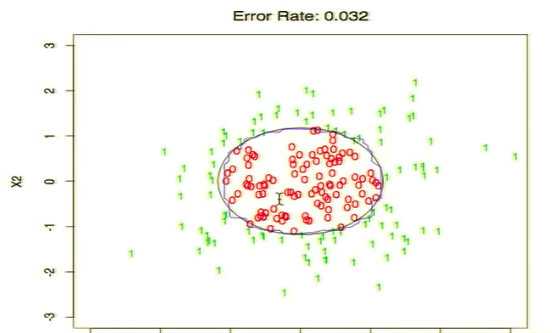
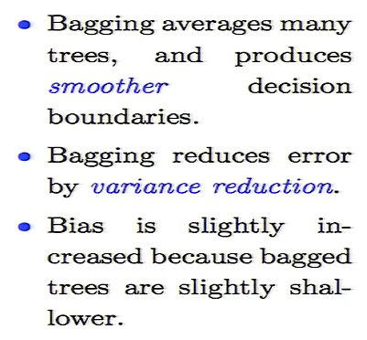
Decision Boundary

Slide 37
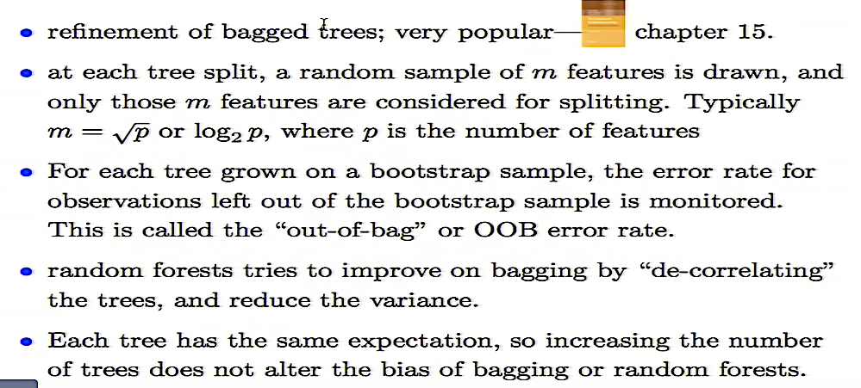
Random Forest - Summary

Slide 38
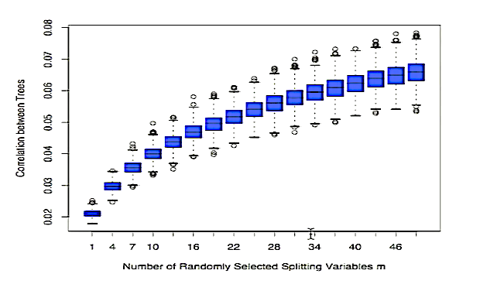
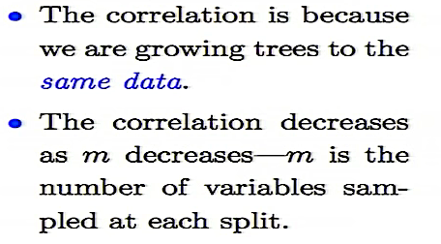
Random Forest - Summary

Slide 39
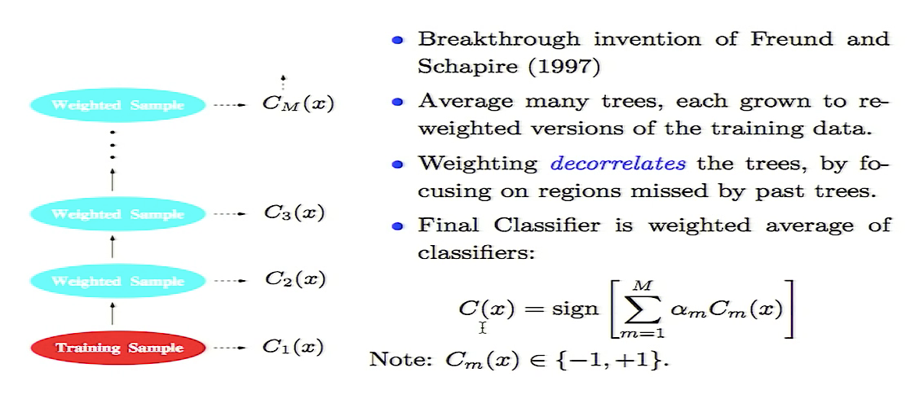
Boosting
Boosting Summary

Slide 40
Advantages of Trees
Highly Accurate: Almost Half of Data Science Challenges are won by Tree Based Models.
Easy to Use – Easy to Implement, Gets Good Performance with Little Tuning.
Easy to Interpret and Control.
Controls Overfitting (Ensemble)
Improves Trainings Speed and Scale up-to - Large Datasets.

Slide 41
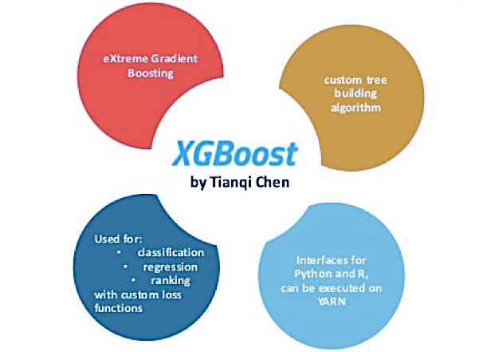
XGBOOST
XGBoost (Extreme Gradient Boosting) is an optimized distributed gradient boosting library.
It uses gradient boosting (GBM) framework at core. Yet, does better than GBM framework alone.
Used for Supervised ML
Serves the purpose of Generalization and Reduction in Error
Its faster because it was written in C++.
XG internally has parameters for cross-validation, regularization, missing values, tree parameters etc.

Slide 42
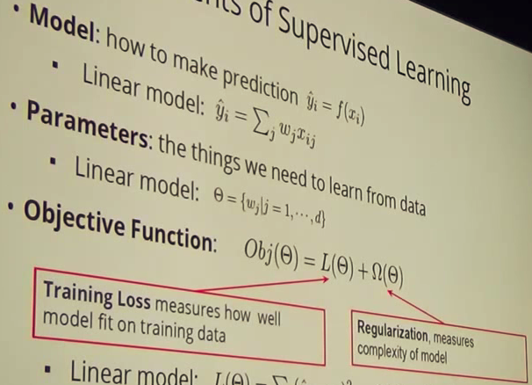
XGBoost Advantage
Regularization: Standard GBM implementation has no regularization like XGBoost, therefore it helps to reduce overfitting. In fact, XGBoost is also known as ‘regularized boosting‘ technique.
Faster Processing: XGBoost implements parallel processing and is blazingly faster as compared to GBM.
Missing Values:XGBoost has an in-built routine to handle missing values. XGBoost tries different things as it encounters a missing value on each node and learns which path to take for missing values in future.
Tree Pruning: XGBoost on the other hand make splits up to the max depth specified and then start pruning tree backwards and remove splits beyond which there is no positive gain.
Built In Cross-Validation XGBoost allows user to run a cross-validation at each iteration of the boosting process and thus it is easy to get the exact optimum number of boosting iterations in a single run.
Can work on both Classification & Regression Problems

Slide 43
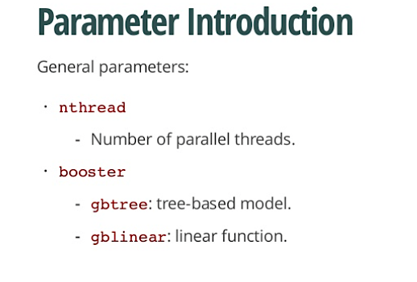
XGBOOST Parameters
Walkthrough

Slide 44
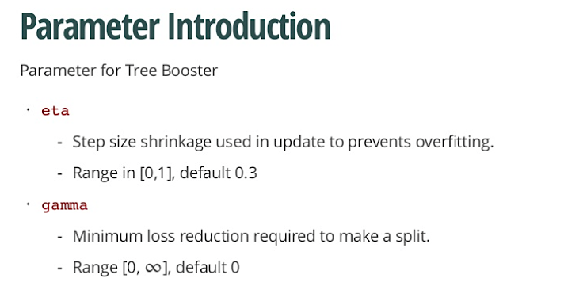
XGBOOST Parameters
Walkthrough

Slide 45
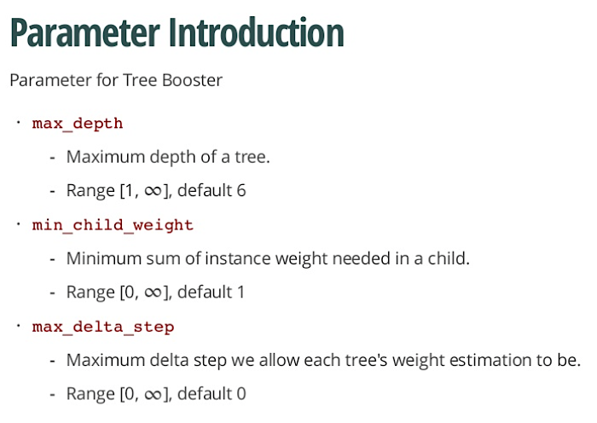
XGBOOST Parameters
Walkthrough

Slide 46
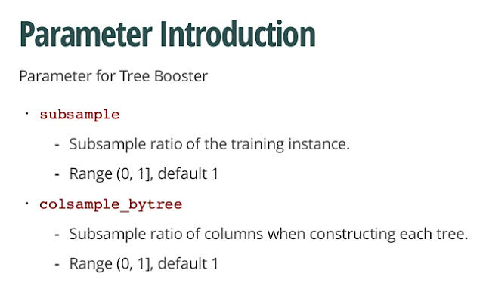
XGBOOST Parameters
Walkthrough

Slide 47
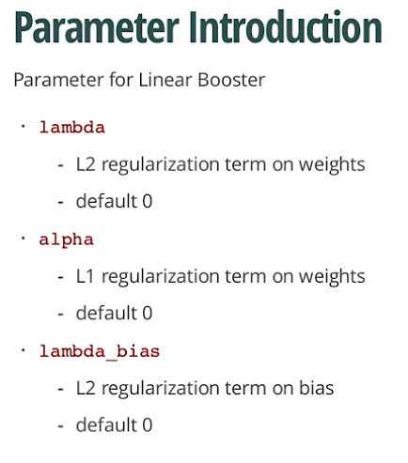
XGBOOST Parameters
Walkthrough

Slide 48
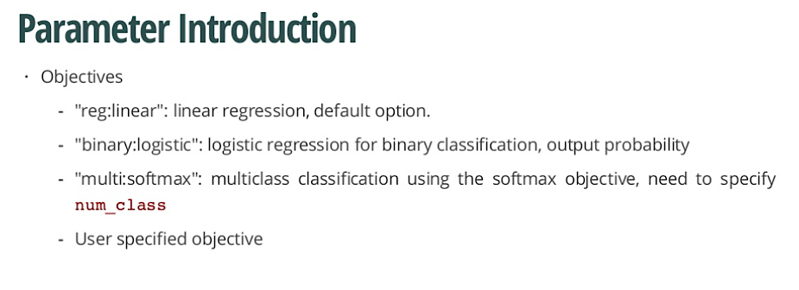
XGBOOST Parameters
Walkthrough

Slide 49
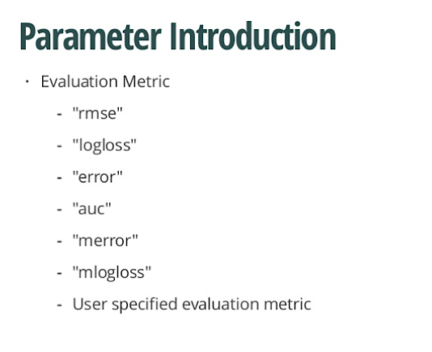
XGBOOST Parameters
Walkthrough

Slide 50
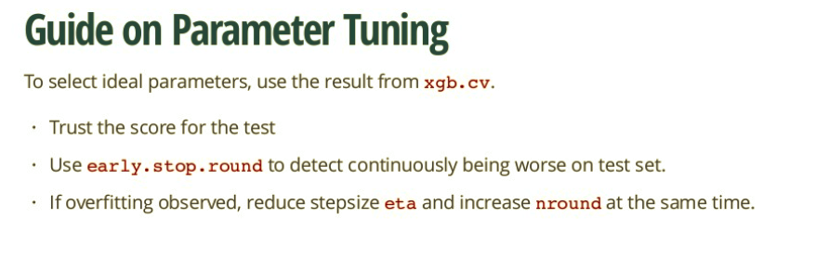
XGBOOST Parameters
Walkthrough

Slide 51
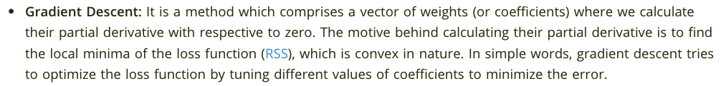
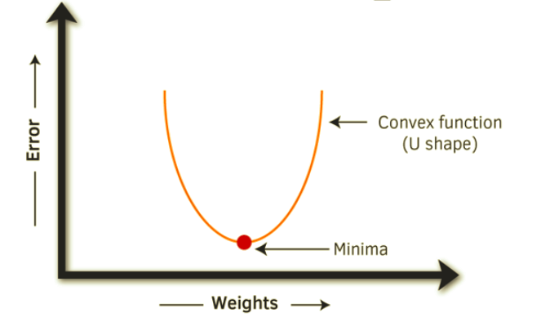
XGBoost Advantage

Slide 52
Industry Examples - Ensembles
Recommender Systems
Adaboost: Face Detection Problems
Malware Detection
Fraud Detection

Slide 53
Thank you

